Slide 1


Accessibility: The Road to Success
February 19 – 21

Slide 2

Conference Schedule
February 19 12:00 PM | KEYNOTE: Accessibility: A Civil Right | Vance Martin , University of Illinois Springfield
February 19 2:00 PM | Mapping Your Success: Universal Design for Learning | Zach Petrea, Heartland Community College
February 20 10:00 AM | Simple Solutions: Accessibility for Audio and Video Resources | Robin Fisch, Sauk Valley Community College Lori Wendt, Parkland College
February 20 2:00 PM | Moving Down the Road to Success: How to Approach Accessibility | Kona Jones, Richland Community College Scott Rial, College of Lake County Susan Nugent, Lake Land College
February 21 10:00 AM | Moving Down the Road to Success: How Different Learning Management Systems Address Accessibility | Kona Jones, Richland Community College Selom Assignon, Harold Washington College Lara Tompkins, College of DuPage
February 21 2:00 PM | Digital Access and YOU | Becky Benkert & Mike Maxse, College of DuPage

Slide 3


Simple Solutions:
Accessibility for Audio and Video Resources
Notes:
Welcome, everyone, to this session, titled Simple Solutions: Accessibility for Audio and Video Resources.

Slide 4
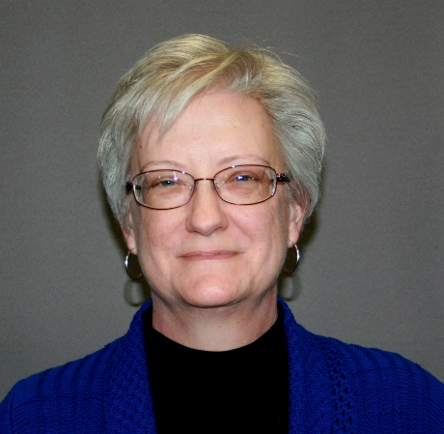


Presenters
Robin Fisch
Instructional Designer
Sauk Valley Community College
Lori Wendt
LMS Specialist
Parkland College
Notes:
Lori and I are happy to be with you today to share our favorite tips for adapting audio/video materials for use in your courses. We'll start with introductions. I'm Robin, and I'm an Instructional Designer at Sauk Valley Community College, where among other duties, I work closely with our Disabilities Services Office.
I'm Lori and as Becky indicated, I’m the LMS Specialist at Parkland College. Like Robin, I work closely with faculty and our accessibility services office to ensure that content is compliant.

Slide 5
Agenda
Legalities (IANAL)
Finding Accessible Videos
Evaluating Videos for Accessibility
Creating Accessible Videos
Creating Accessible Audio
Resources
Questions
Notes:
Here is what we intend to cover in the next hour, starting with the “why accessibility” which is the law. (IANAL stands for I am not a lawyer, so we’re making recommendations based on the interpretations of the law). We’ll talk about finding accessible video and how to evaluate it for accessibility. Then we’ll get into creating your own video and audio files and how you can ensure their accessibility as well. Lastly, we’ll cover some resources for you as well as take any questions that you have.

Slide 6
Section 504 of the Rehabilitation Act of 1973
Institutions may not deny individuals with disabilities the opportunity to participate in electronic communications.
Notes:
One reason we need to make audio and video course materials accessible is to comply with legal requirements such as Section 504 of the Rehabilitation Act of 1973, which requires that individuals with disabilities have the opportunity to participate in electronic communications.

Slide 7
Title II of the Americans with Disabilities Act of 1990
Institutions must take appropriate steps to ensure that communication with those with disabilities is as effective as communication to those without disabilities.
Notes:
In addition, Title II of the Americans with Disabilities Act of 1990 requires that communication with students with disabilities be as effective as communications to those without disabilities. Now, I like to emphasize that the legal requirement isn't the only reason to make your course materials accessible. Accessible materials are also handy for students without disabilities – for instance, students who are working parents and are using the materials late at night while children are sleeping, students watching videos on breaks at their part-time job, or while using public transportation can all appreciate closed captions. Making materials accessible makes them more useful to more students in more situations.

Slide 8
Audio Accessibility Standards
Audio resources should be clear and easy to understand.
Provide an accurate transcript of the audio.
Synchronized captions are another option and are helpful to English language learners and some students with processing disabilities or dyslexia.
Synchronized captions can be created with Techsmith’s Camtasia, using a title slide as the graphic image throughout.
Notes:
So, let's take a look at the standards for accessible audio and video.
Audio resources need to be clear, and easy to understand. In addition, a transcript or captions should be provided. In most cases, a transcript will be adequate. However, there are some advantages to providing synchronized captions rather than a transcript. Synchronized captions can also be helpful to some students with processing disabilities, dyslexia, or those who are English language learners, because they allow the student to read the content as it is heard.

Slide 9
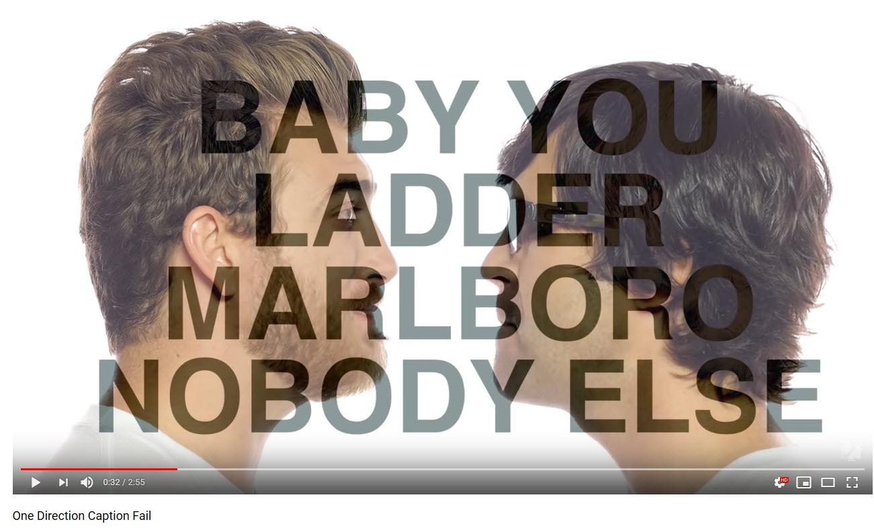
Video Accessibility Standards
Captions provide access to students with learning disabilities or hearing loss.
Captions must be:
    accurate (include the exact wording)
    properly punctuated
    synchronized to the audio
    always available
An accurate caption would read: Baby, you light up my world like nobody else.
Notes:
All video resources should include captions. The captions must be accurate, including the exact wording of the audio track, properly punctuated, and synchronized to the audio. This is where instructors must take care when selecting video content from YouTube or other publishers, as they will often include auto-generated captions that haven't been proofed and corrected. Sloppy captioning can change the meaning of entire sections of a video! You may be familiar with the YouTube video "One Direction Caption Fail," where the video creators showcased the captions provided by automated services. It is a great example of poor, inaccurate automated captions.
In addition, the captions must always be available to the users.

Slide 10
Video Accessibility Standards, continued
Audio provides access to students who are visually impaired.
Audio tracks should:
    be clear and easy to understand
    provide information equivalent to that available to the sighted.
Notes:
The audio portion of a video needs to be clear and easy to understand. In addition, when evaluating the audio track of a video, consider whether a student with a visual disability would be able to obtain equivalent information by listening. Some video resources pack all of the information into the audio track, and the visual content serves as decoration.

Slide 11
Video Accessibility Standards – audio description
When visual content is critical to the message and not described in narration, audio description is necessary.
Notes:
Visual content that is critical to the message must be communicated to students with disabilities in order to provide that equivalent experience required by law. Audio description is a way to communicate the content. A narrator describes the visual content, and it is interspersed with the existing audio track.

Slide 12
Finding Accessible Video
Check for accessibility when selecting audio-visual content for a course.
School librarians can help find suitable materials (Films on Demand, LinkedIn (formerly Lynda))
Check with publisher representatives for captioned and audio described resources that accompany textbook adoption.
YouTube/Google searches
Notes:
Life is easier when you can find video that has already been created with the accessibility features you need. Don’t assume that all published content is accessible. We suggest checking with your college librarian, checking with the representatives of your textbook publisher during the textbook adoption phase for captioned and audio described resources to accompany the text. In addition, we have a few tips on searching YouTube and Google for videos.

Slide 13
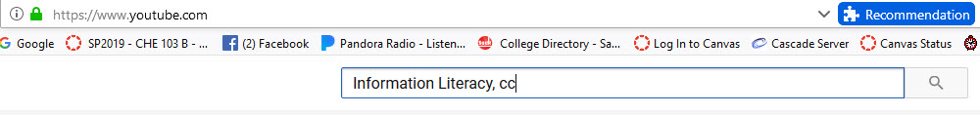
Search YouTube
YouTube search: type the name of your search and add ,cc
Notes:
To find YouTube videos with existing closed captions, add a comma and the letters cc after your search terms.

Slide 14
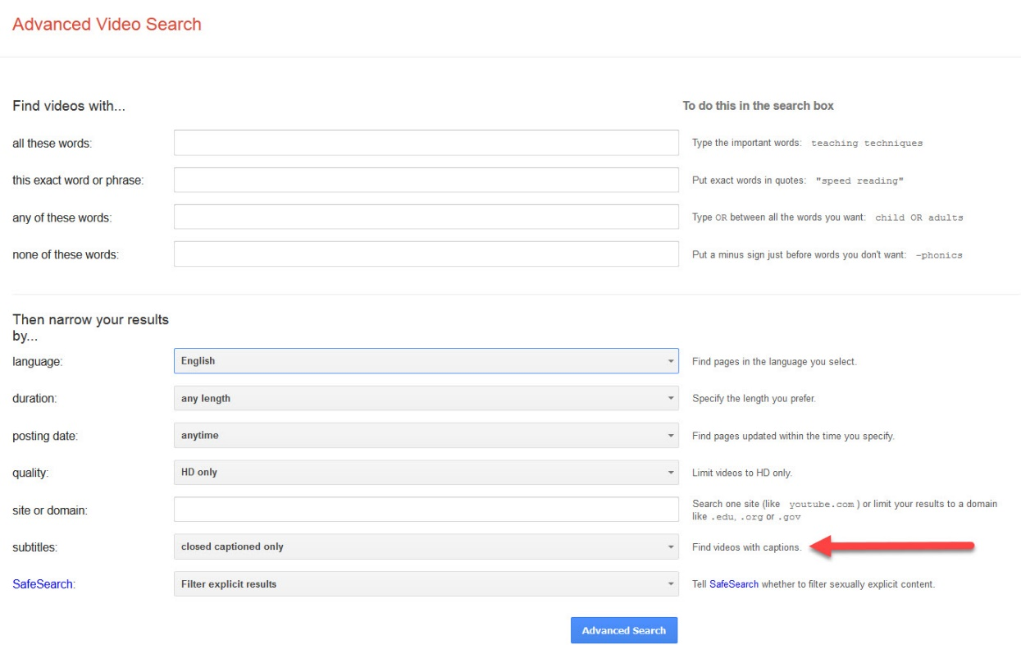
Search Google https://www.google.com/advanced_video_search
Notes:
Using advanced video search at google, select "find videos with captions" as an option in the subtitle field.

Slide 15
Evaluating Video, Step 1
Play the video with sound on, but close your eyes.
  Are you able to follow the meaning of the video?
  Are key concepts clear without the visual content?
Notes:
Once you have located a video with the content you want, evaluate it for accessibility. First, evaluate the audio track by playing the video and listening to it with your eyes closed. Are the key concepts clear just from listening to the audio track? If not, you will want to consider audio description.

Slide 16
Evaluating Video, Step 2
Play the video with the sound off and captions on:
    Do the captions include punctuation and proper capitalization?
    Are you able to follow the meaning of the video throughout?
Notes:
Next, play the video with the sound turned off and the captions on. Read the captions as the video plays. Do the captions include punctuation and proper capitalization? Are you able to follow the meaning of the video throughout, or does the timing seem to be off?

Slide 17
Evaluating Video, Step 3
  Play the video with the sound on and the captions on:
    Do the captions portray what is actually being said?
    Are they synchronized with the action?
Notes:
Finally, turn the audio back on and watch with attention on the sound and the images. Do the words in the captions match what is actually being said? Are they synchronized with the action of the video? If the captions are accurate, you won't need to do anything else to prepare the video.

Slide 18
Resources for Audio Described Video
National Library Service for the Blind and Physically Handicapped (https://www.loc.gov/nls/about/services/reference-publications/guides/audio-description-resource-guide/)
The Audio Description Project (https://www.acb.org/adp/index.html)
Vimeo (https://vimeo.com/)
  Enter “audio description” in the search bar
Notes:
Publishers and YouTube content creators are adding good captions to more and more videos. However, audio described materials are still a challenge to obtain. A few resources for obtaiing audio described video include the National Library Service for the Blind and Physically Handicapped and The Audio Description Project. Vimeo has a small selection of available video with audio description, which you can find by entering audio description in the search bar.

Slide 19
Resources for Audio Described Video, cont.
Described and Captioned Media Program Located at dcmp.org
  Funded by U.S. Department of Education
  Content for Pre-K through Grade 12
  Free membership required to utilize materials
Notes:
Another resource might be the Described and Captioned Media Program, which is funded by the US Dept of Education. However, it provides material for Pre-K through Grade 12. There are companies that will provide both captioning and audio description for a fee, such as Three Play Media. This can be an excellent option in cases where copyright is at issue. Captions as an overlay that appears over the video without altering it or requiring copying of the video. Audio description is provided in an audio track or text form. If this service is needed, the Disabilities Services Office at your institution may have an account and funding to cover the expense.

Slide 20
Creating Accessible Video - Preparation
Script (if possible)
Equipment
Environment
Background/inset video
Color/contrast
Software
  Jing (free, 5 minute limit, must edit in another software)
  Screencastify (free, 10 minute limit, must edit in another software)
  Screencast-o-matic (low price, more features)
  Camtasia
  iMovie
Notes:
Sometimes you need to create custom videos for your course, but don’t let the idea of creating accessible videos be a deterrent for you. We’ll cover these first 5 items in the next few slides in more detail. So, for this one we want to talk about the software that you’ll use to create your videos. Some popular free downloads include Jing by Techsmith and Screencastify which is a Google Chrome add-on. Screencast-o-matic is another one that is free, but for about $18 per year, you can upgrade and get longer recording times and editing capabilities. Camtasia by TechSmith is the big name in screen-recording, but it comes with a hefty price tag of about $170. You get a lot of bang for the buck…some might say too many features for what you want with simple video creation. So, it’s best to start with the low-end free ones and test the waters before spending much money on software. You might also check with your institution as some have licenses for labs that you can use to create the videos on campus without any cost to you. iMovie is the popular video creation software for Apple users and is typically free with most Mac computers. There is a bit of a learning curve with it, but it does offer editing capabilities.

Slide 21
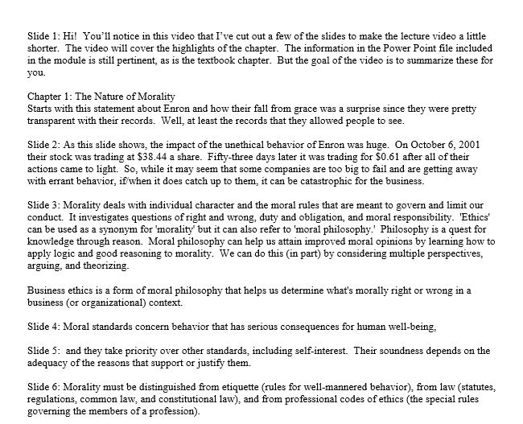
Script
Notes:
If you are creating a video that is describing an on-screen action, then a script might not be useful; but that means that the captioning must all be done by the auto-captioning tool and then manual correction must be done, including punctuation and capitalization.
However, if you are doing a voice-over PowerPoint or lecture, then typing out a script as this example shows, can help with captioning later. A side note: you can learn to read from the script and make is sound natural, it just takes a few tries; but a side benefit to this is it cuts down on the number of “ums” and “sos” that you might otherwise pepper into your speech.
Note also on this script that I have included the slides numbers. These are helpful as identifiers for the students as well as for me with syncing my captioning to the proper slide.

Slide 22
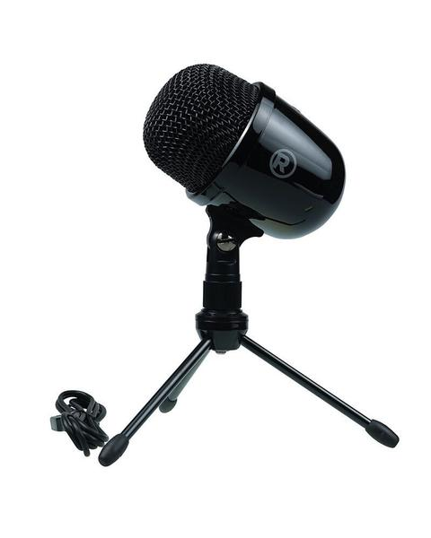
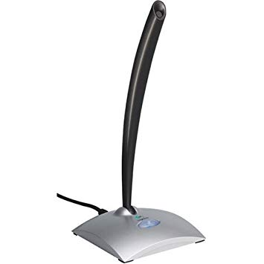
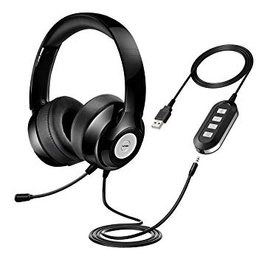
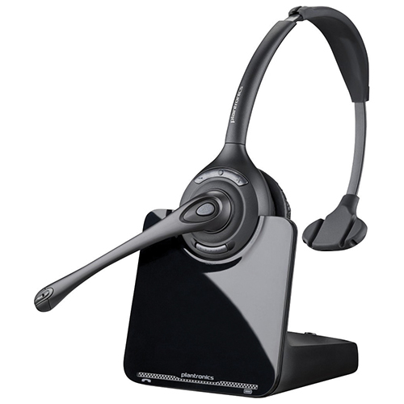
Equipment
Notes:
Using a computer built-in mic is not necessarily the best for good audio. The microphone should be near your mouth for picking up audio and lessening the background noise. Microphones have a wide range of pricing such as the ones shown here.
Radio Shack desktop microphone $35
Logitech desktop microphone $130
Plantronics wireless headset $240
VTN USB headset $24
You don’t need the most expensive one, so choose one that is comfortable for you. If you won’t like wearing a headset, then get a free-standing microphone instead.

Slide 23


Environment
Notes:
A room with high ceilings and wood flooring will tend to be echo-y, even with a good microphone. My home office has wood floors and I had to pause video recording frequently when our dog came into the room because you could hear her nails clicking on the floor. Having a small area with carpeting and noise-dampening furnishings will help to keep background noise to a minimum. Having natural lighting is best, like from a window; but using soft lights and lamps will do. If the weather is nice, you might be tempted to have the windows open. However, if there is traffic or dogs barking or mowers running, it can also be heard in your video.

Slide 24
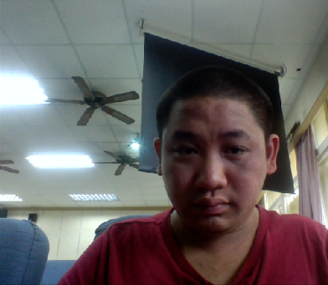
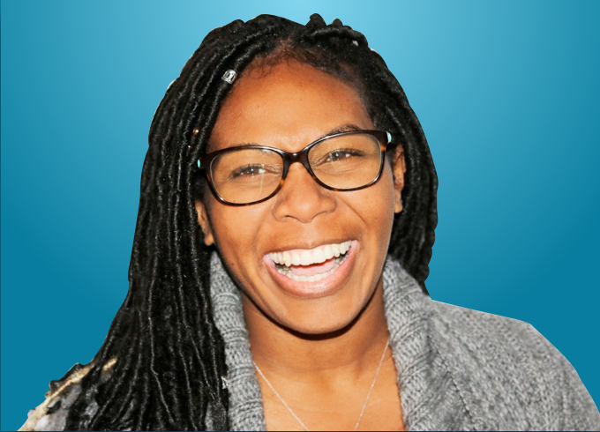
Background/Inset Video
Notes:
If using webcam, need a clean, clear background with no distractions. Again, think of the windows…having them open for lighting may be nice, but if they behind you then anything outside that window may distract the viewer from the context of the video. Make sure you don’t blend in with the background color, either. And ideally, your webcam will be face on with you instead of you looking up or down at the camera.

Slide 25
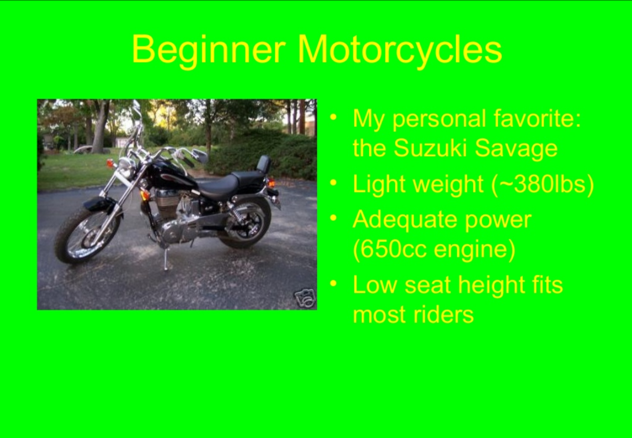
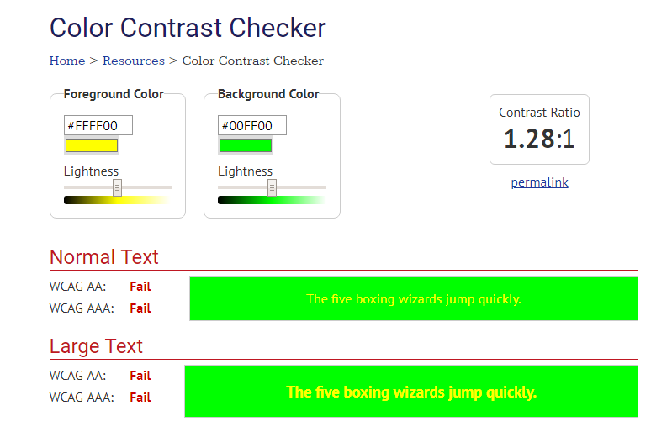
Color/Contrast
Notes:
If you’re doing a PowerPoint narration, then make sure your PowerPoint file is accessible BEFORE recording including ensuring color/contrast compliance. Using WebAIM’s color contrast checker will ensure that your presentation meets WCAG guidelines. And if you do use images, then consider describing them (if they are pertinent to the message) so that blind users know that the image is significant to the lesson.

Slide 26
Creating Accessible Video - Finishing
YouTube/Microsoft Video/Techsmith Relay auto-caption
  Need to correct punctuation, spelling
Include transcript (written script)
Audio description (YouDescribe)
Notes:
Once you’ve recorded your video and edited it, it’s now time to finish it. Uploading it to a storage site that also auto-captions is a good idea, such as YouTube, Microsoft Video (formerly Stream), or TechSmith Relay. YouTube can be unlisted so that not just anyone can access your video, but it will give recommended videos at the end. Microsoft is nice in that the videos are not public nor do you get a list of videos at the end. However, you must be logged into your institutional Office 365 account in order to view the video.
You need to ensure that you have a transcript of the video to provide along with audio descriptions where necessary.

Slide 27
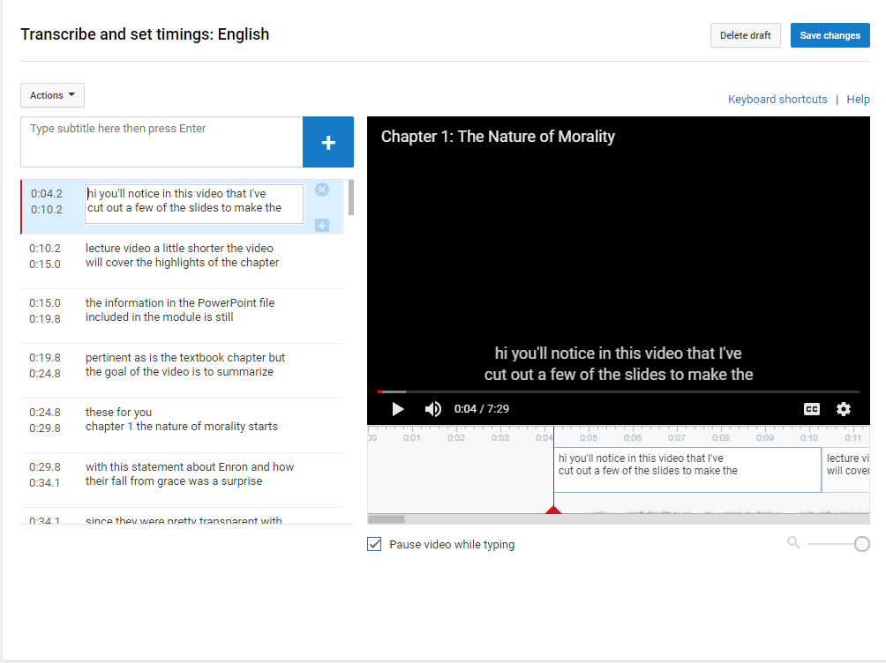
YouTube Auto-Caption
Notes:
Once you upload a video to a service like YouTube, it will auto-caption is with about a 90% accuracy, if you have recorded it with really good audio. Then, you can edit it to correct punctuation, capitalization, and spelling. This is where you can also set the timings to ensure that the captions correspond with the audio.
Once you’re done with the captions, you have the ability to download the captions, creating a printable transcript to include in your course with the video.

Slide 28
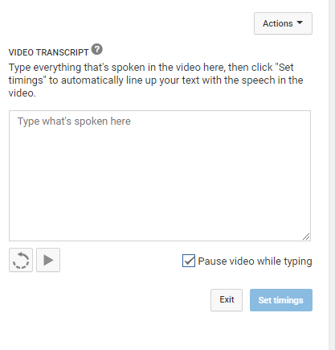
YouTube Transcribe and Auto-Sync
Notes:
An option that YouTube has, though, is to transcribe the video. This is where I take my typed script, copy it, and then paste it in and allow YouTube to auto-sync it to the video. My typed script has all of the correct punctuation, capitalization, and spellings. So, all I have to do is go through and ensure that the timings are correct. Makes it much easier to caption my videos. Also, having this typed script can serve as my print transcript to include with my video.

Slide 29
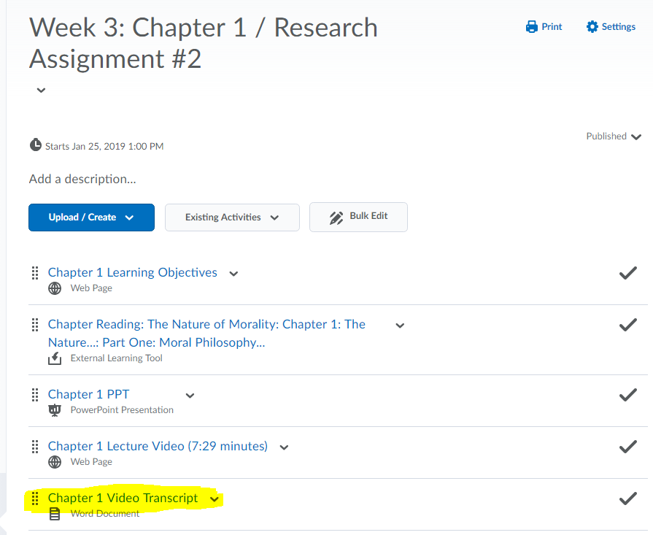
Including the Transcript
Notes:
The transcript that I showed you previously was used three times: once as my prompt for reading during the recording, again when I uploaded it into YouTube to sync the captions, and lastly to upload the Word document into the LMS to share as the print transcript for the students. So typing a script can truly be a time-saver with regard to accessibility.

Slide 30
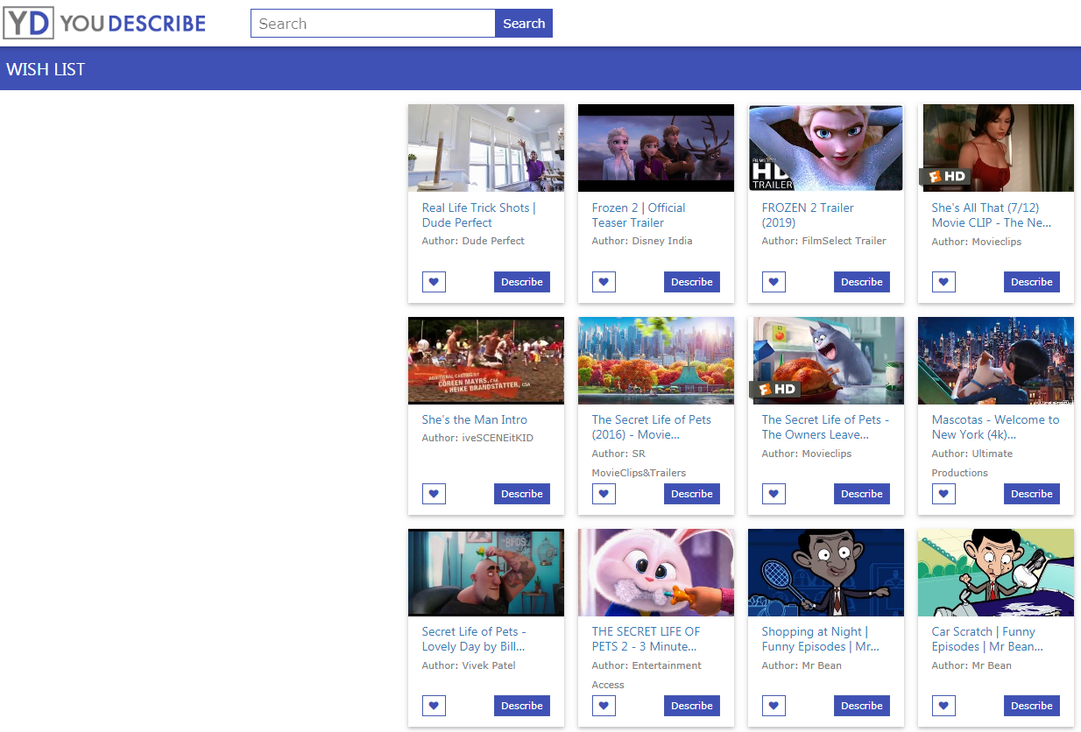
Audio Descriptions
Notes:
Creating audio descriptions are not an easy task and can be just as time-consuming as creating the original video. But if you don’t mind crowd-sourcing, then you can upload your video to YouDescribe and place on the wish list to have the audio descriptions put into the video for you.

Slide 31
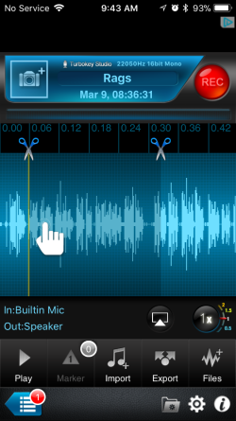
Creating Accessible Audio - Preparation
Same as video preparation:
  Script (recommended)
  Equipment
  Environment
Software
  Audacity
  Recorder Plus (iOS)
  Adobe Audition
Notes:
When you are creating audio content, perhaps an MP3 or podcast lecture, consider the same things as you do for video: use a script, a good microphone, and make sure your environment is good for audio recording.
Popular software for creating audio recordings include Audacity, Adobe Audition, and Recorder Plus (which is what I have used for iOS). However, you can use any software that is compatible with your device and with which you are familiar. The key is to create a file (MP3) that is portable across all platforms and does not require special software for listener.

Slide 32
Creating Accessible Audio- Finishing
Camtasia (voice recognition), Express Scribe (manual transcription)*
Include transcript (written script)
*YouTube won’t caption audio unless it has a “video” or image component, so if you create a video file from your audio, then you can use YouTube to auto-caption
Notes:
Once you have completed your recording, you’ll need to create a transcription of the file. If you typed up a script, then your work here is done. You simply upload that text file with the audio clip/link and your students have access to the audio file content. If you spoke off-the-cuff, you’ll need to either import the audio file into Camtasia (or another editing tool) and use voice-recognition to partially auto-caption the file. (Camtasia only captions at about a 60% accuracy, so you’ll need to do a lot of editing). Or you can use a software like Express Scribe to manually transcribe (type) the audio using keyboard shortcuts to make it easier.
A lot of people ask about YouTube captioning of audio files, and it *can* do so…but the basis for YouTube is video, so you’ll need to create a video-type file, like an .mov or .mp4 out of the audio, which means an image file needs to be included. But if you do that, you can then upload and let YouTube caption the audio.

Slide 33
Resources
W3C Multimedia Accessibility FAQ (https://www.w3.org/2008/06/video-notes)
6 YouTube Hacks for Captioning and Subtitling (https://www.3playmedia.com/2018/03/29/5-youtube-hacks-for-captioning-and-subtitling/)
WebAIM Color Contrast Checker (https://webaim.org/resources/contrastchecker/)
Three Play Media
(https://www.3playmedia.com/)
Notes:
You may be interested in these resources to extend the learning from today’s session.

Slide 34

Questions?

Slide 35
Conference Archives
Recordings of these presentations will be available at:
ILCCO (http://www.ilcco.net/)
under Resources & Events
For more information about ILCCO:
jeff.newell@illinois.gov

